Slide 1
Haystack Webinar Series
nHaystack
B. Scott Muench
Vice President of Marketing and Business Development

Slide 2
Who is J2 Innovations?
Company Overview
Founded in 2009
HQ in Chino, California
20 talented employees globally
Offices located in:
Chino, California
Richmond, Virginia
Bucharest, Romania
“Our goal is to enhance the way humans interact with the connected world”

Slide 3
What is nHaystack?
Technology Overview
nHaystack is an open-source Niagara AX module that enables Niagara stations (JACE and WebSupervisor) to serve data in the Project Haystack format, via a RESTful protocol. Using nHaystack, external applications receive data that includes essential meta data (tags) to describe the meaning of the data.

Slide 4
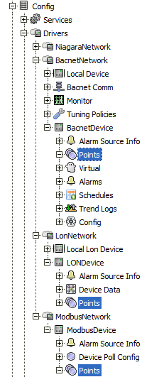
The Challenge with Current BAS Installations?
Technology Overview
Today open protocols like BACNet, LONWorks, and Modbus have significantly increased the standardization and interoperability of disparate systems.
Unfortunately the information is still in many places and locked up in the point data which can have widely varying point names to describe the meaning of the data.
OSA_temp
MainMeter
OAT
RMT_SP
AHU-1_SA
Zone_1_temperature
Bld321_Elec_Meter
DAT
RTU_5-HeatStage1
RHT_765SUPTEMP

Slide 5
Technology Overview

Slide 6
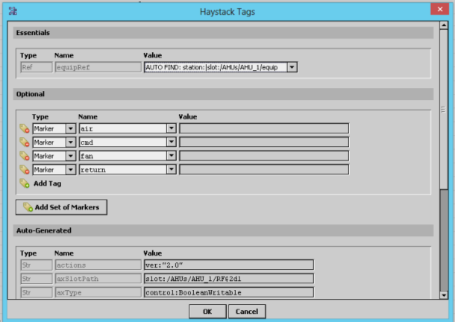
What does nHaystack do for the me?
Technology Overview
nHaystack automatically generates standard tags for all the ControlPoints in your system.
This feature allows for connecting immediately to the Niagara Station via Haystack once the nHaystack module has been installed, without requiring any further configuration.

Slide 7
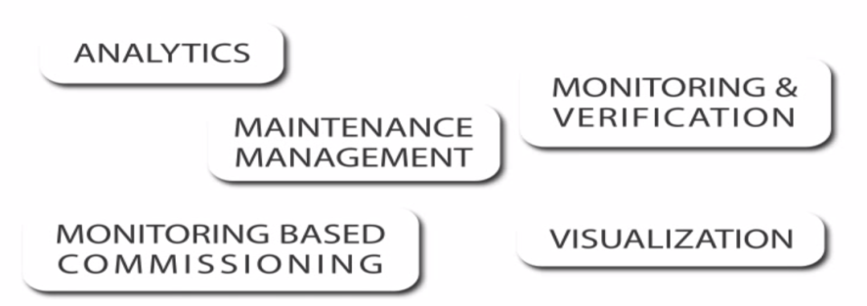
What does nHaystack do for the me? (continued)
Technology Overview
nHaystack also streamlines the process of adding user-specified Haystack tags to Niagara systems by providing a GUI tool that allows users to add the tags directly to Niagara components. Once tags have been defined, the data associated with the Niagara components, including the tags, are available over the Rest communications interface. It makes discovering the points in your station as easy as issuing a simple query.

Slide 9
Analytic Data Visualized with HVAC Data Example
Technology Overview

Slide 10
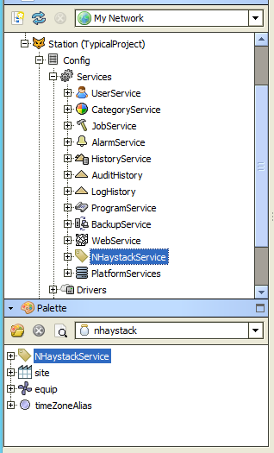
How Can I get Started Using nHaystack?
Getting Started
To get started, install nhaystack.jar into an AX station. Then open the nhaystack palette in Workbench, and drag-and-drop the NHaystackService onto the "/Services" folder of your station.
This is all you need to do to get rolling. Your station is now automatically serving up all its ControlPoint objects and Histories as haystack point recs, via the Haystack REST Api. Many of the tags that are defined as being associated with points, like kind, unit, tz, his, cur, etc. are automatically generated for you.

Slide 11
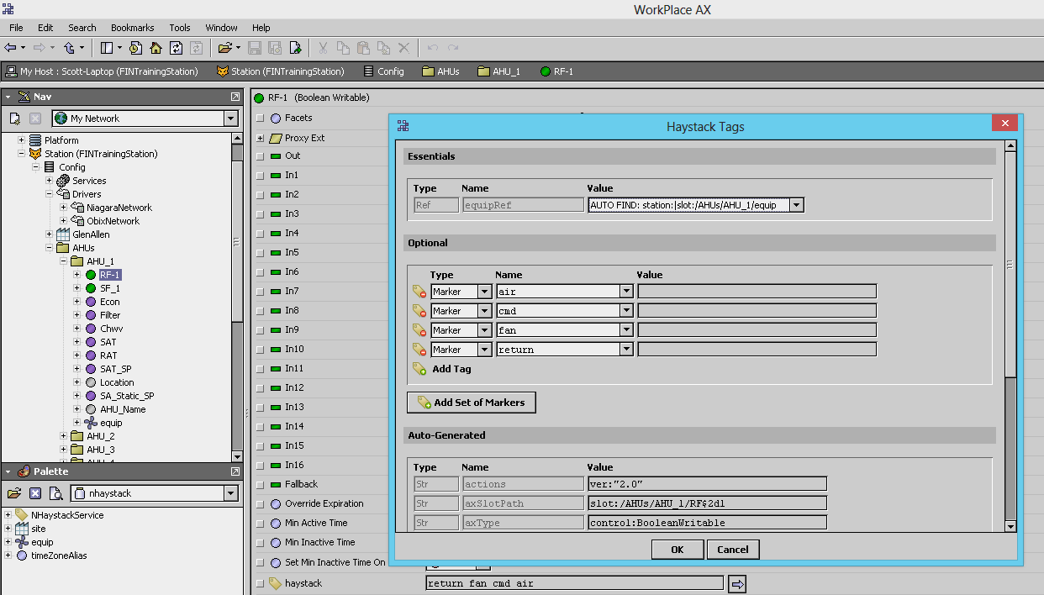
Live Demo:
Getting Started

Slide 12
To Learn More about Project-Haystack and nHaystack:
Resources
http://www.project-haystack.org/
http://project-haystack.org/download
http://www.skyfoundry.com/file/77/NHaystack-Overview-White-Paper.pdf
https://bitbucket.org/jasondbriggs/nhaystack
http://automatedbuildings.com/news/aug13/interviews/130730114004briggs.html
http://www.youtube.com/watch?v=VkrS8QzD_b4
http://vimeo.com/66602016

Slide 13
More about J2 Innovations:
Thank you!
B Scott Muench
scottm@J2INN.com
(909) 631-4141 direct
www.j2inn.com
www.facebook.com/FINproducts
http://www.youtube.com/user/FINproducts
http://www.linkedin.com/groups/FINproducts

